Slide 1

Adapter Design Pattern

Slide 2
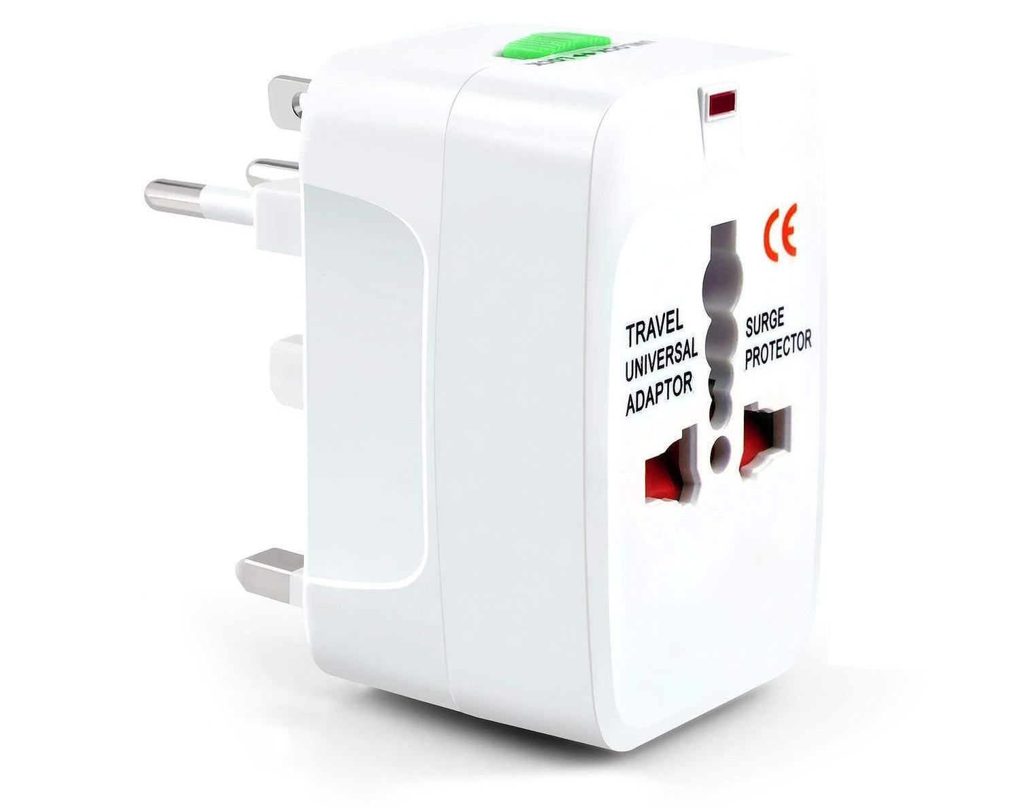

Slide 3
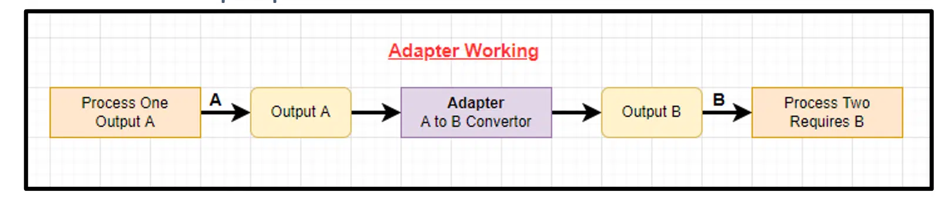
Working

Slide 4
Adapter Design Pattern
An Adapter Pattern says that just "converts the interface of a class into another interface that a client wants".
In other words, to provide the interface according to client requirement while using the services of a class with a different interface.
The Adapter Pattern is also known as Wrapper.

Slide 6
Advantage of Adapter Pattern
It allows two or more previously incompatible objects to interact.
It allows reusability of existing functionality.

Slide 7

Usage
When an object needs to utilize an existing class with an incompatible interface.
When you want to create a reusable class that cooperates with classes which don't have compatible interfaces.
When you want to create a reusable class that cooperates with classes which don't have compatible interfaces.

Slide 8
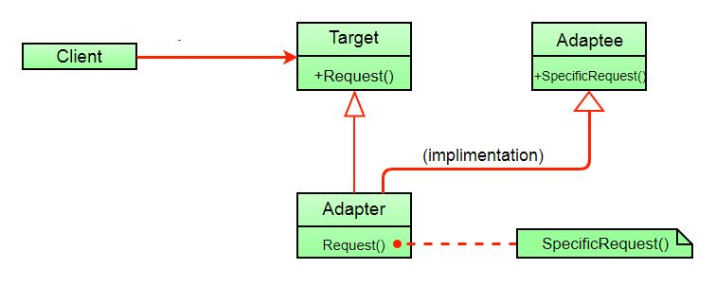
Major Components

Slide 9
Major Components
Target Interface: This is the desired interface class which will be used by the clients.
Adapter class: This class is a wrapper class which implements the desired target interface and modifies the specific request available from the Adaptee class.
Adaptee class: This is the class which is used by the Adapter class to reuse the existing functionality and modify them for desired use.
Client: This class will interact with the Adapter class.

Slide 10
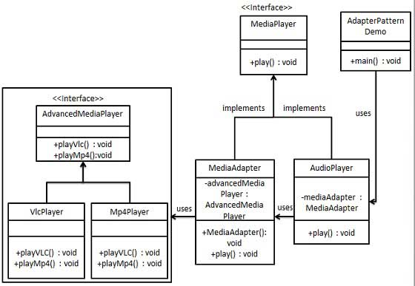
Example

Slide 11
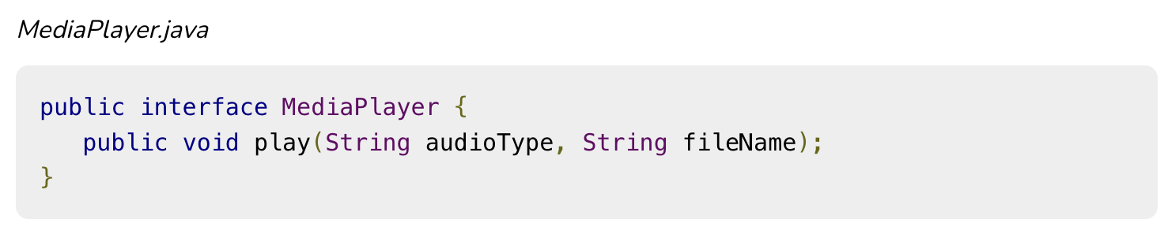
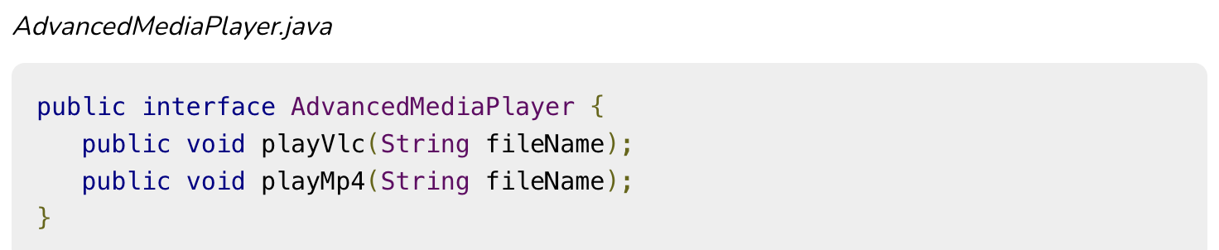

Slide 12
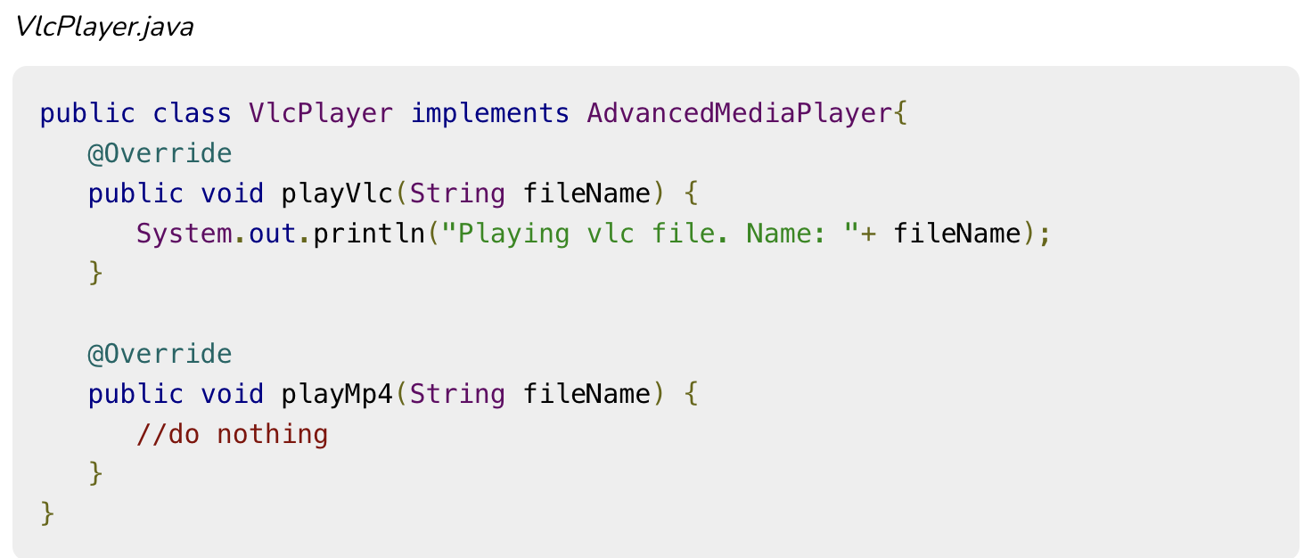

Slide 13
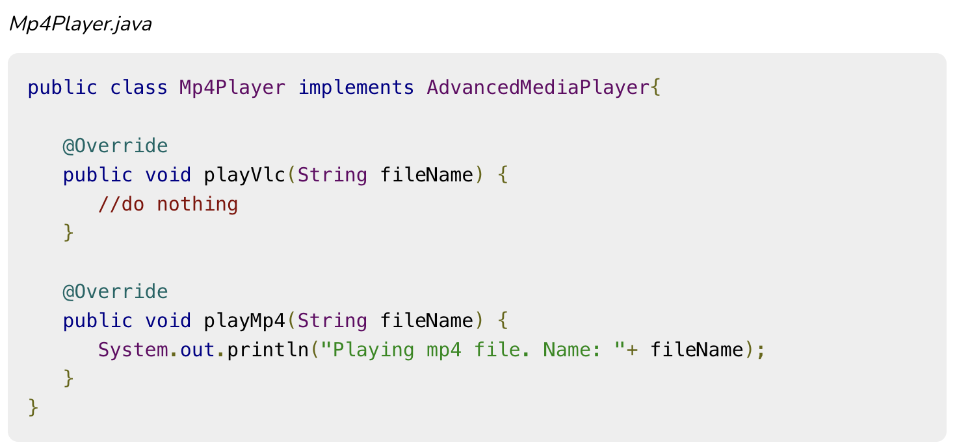

Slide 14
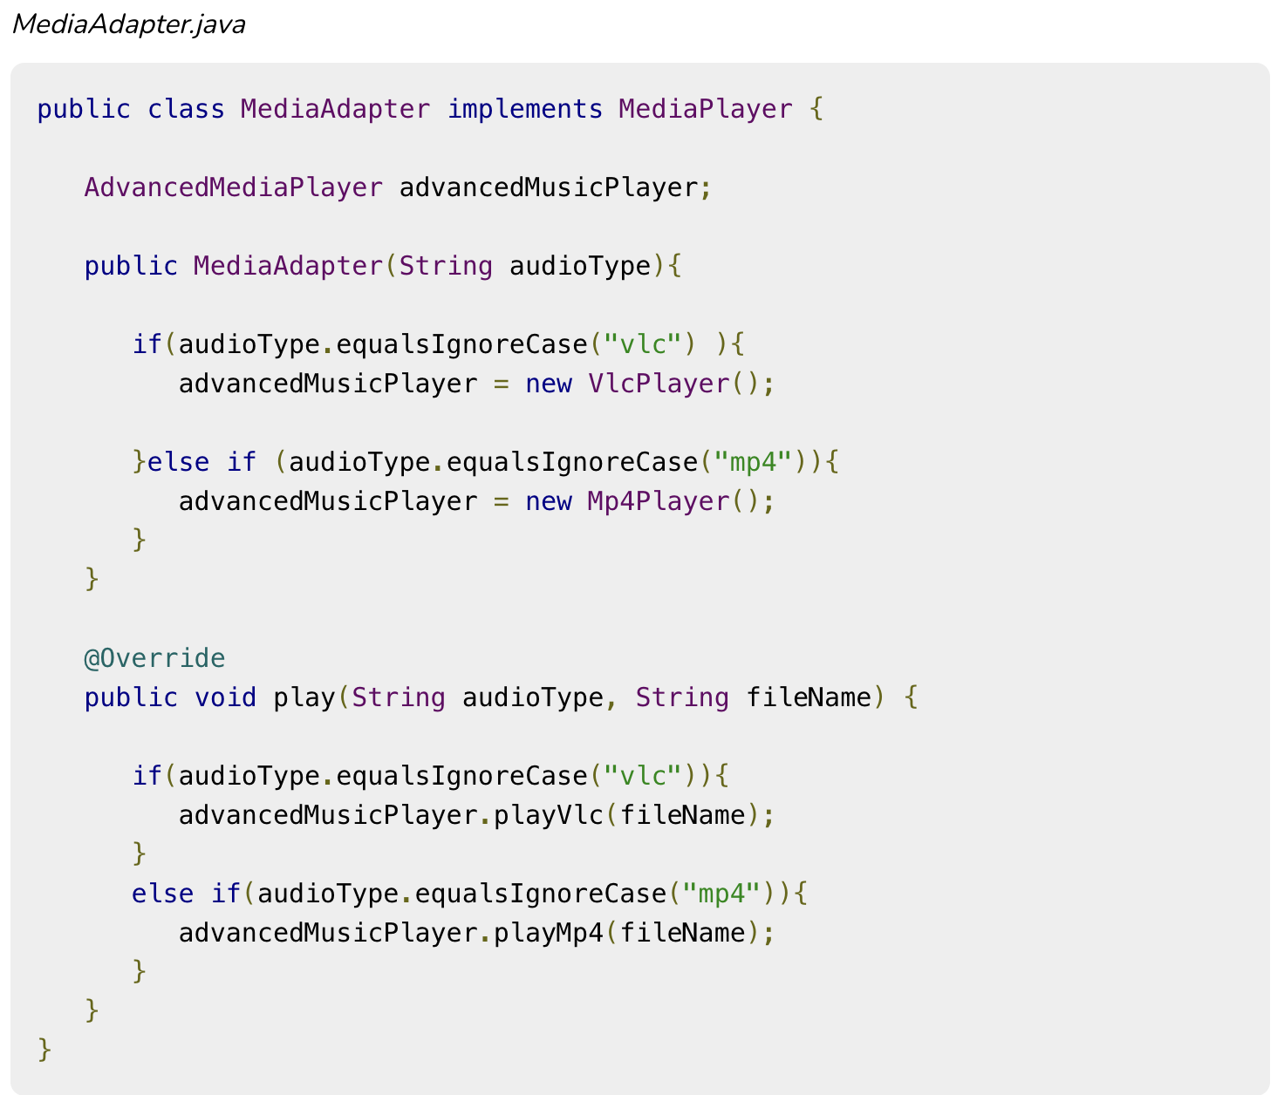

Slide 15
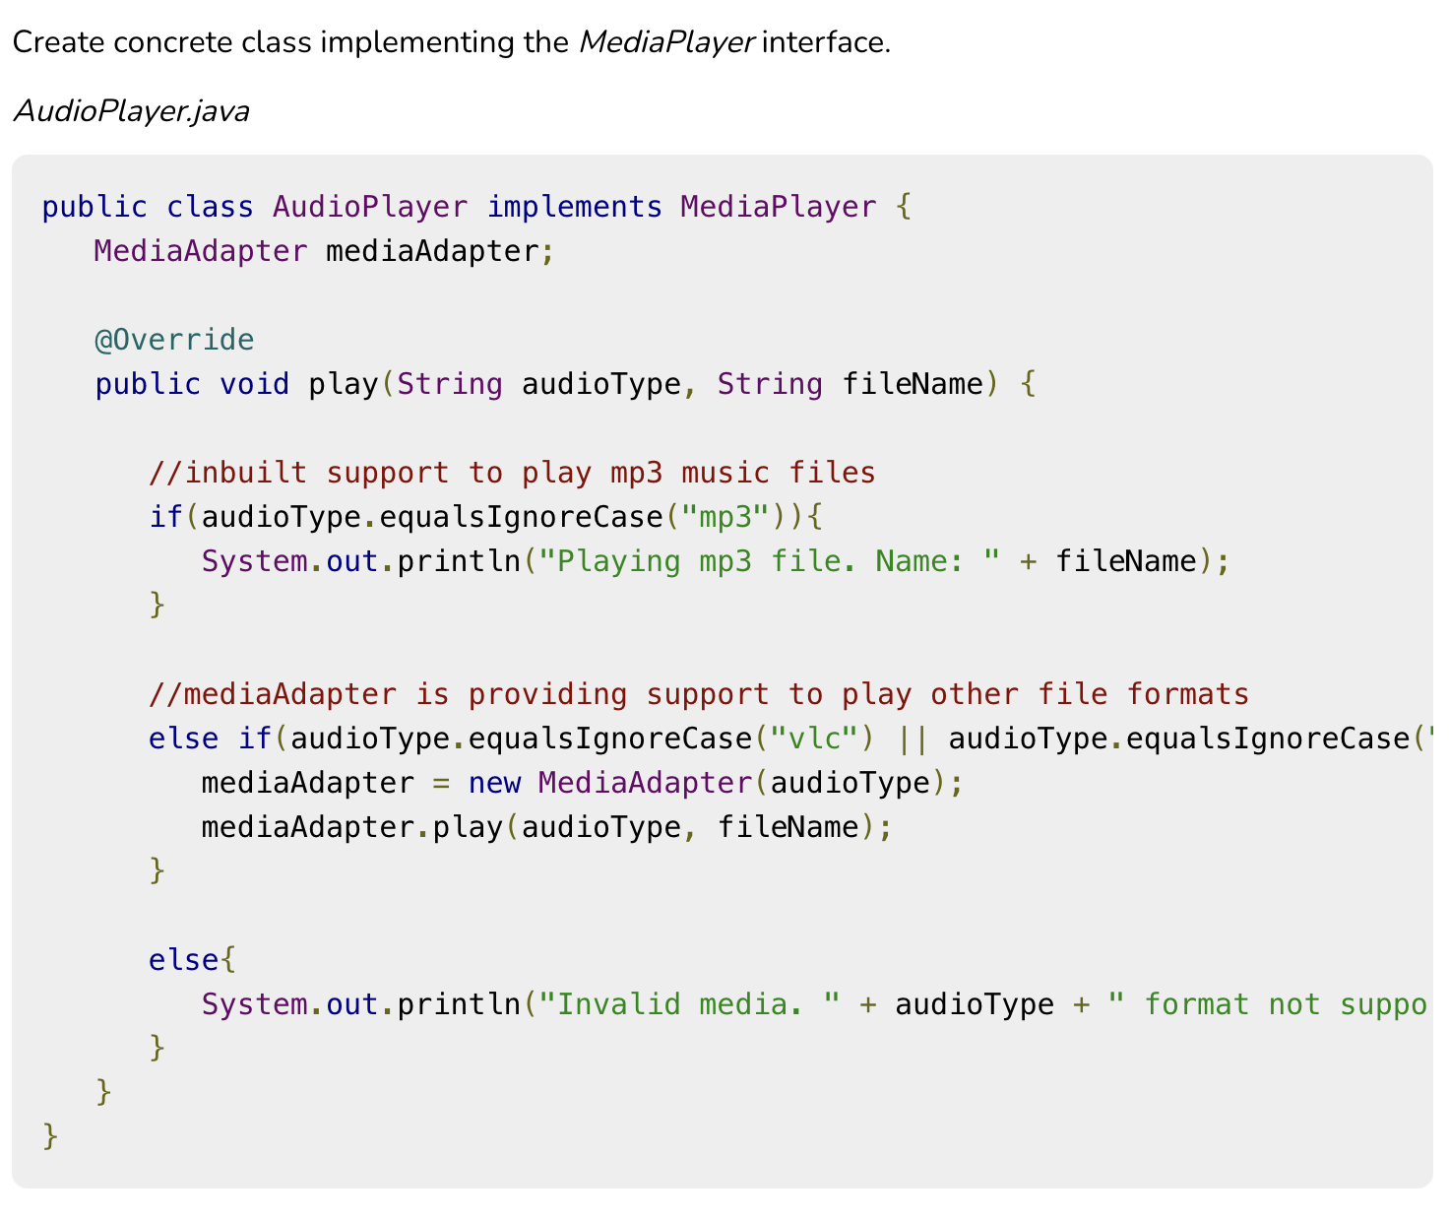

Slide 16
